Slide 1
UMLs
Relationships

Slide 2
What is UML diagram?
UML stands for Unified Modeling Language.
It's a rich language to model software solutions, application structures, system behavior and business processes.

Slide 3
Purpose
visually representing a system along with
Actors
Roles
Actions
artifacts or classes
to better understand a system

Slide 4
UMLs:
use case
Class
Sequence
State
Activity
object
component

Slide 5
Note:
interface diagram is not UML diagram

Slide 6
Use Case Diagram
Already discussed

Slide 7
Class Diagram
Class diagram describes
the attributes
operations
Constraints(if present) imposed on the system

Slide 8
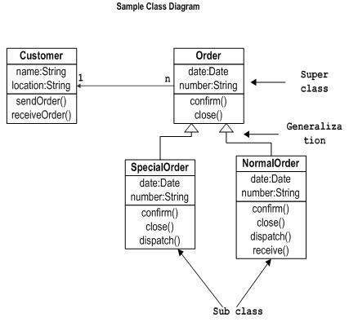

Slide 9
Relationships in Class Diagrams
Classes are interrelated to each other
Relationships include different types of logical connections
Association
Inheritance/Generalization
Aggregation
Composition
Reflexive Association
Multiplicity
Realization

Slide 10
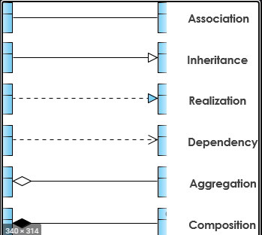
Relationship Representation

Slide 11
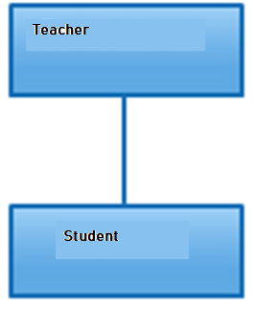
Association
Its a broad term that encompasses just about any logical connection or relationship between classes.

Slide 12
Association
has-a” relationship
In this relationship all objects have their own lifecycle and there is no owner
Both can create and delete independently.

Slide 13
Inheritance
“is-a” relationship
Example : shape class
Circle is a shape; Rectangle is a Shape.

Slide 14
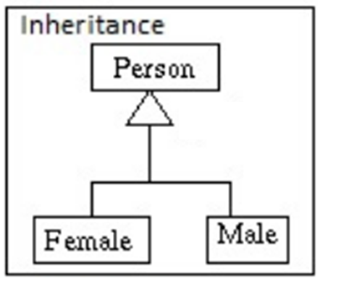
Inheritance

Slide 15
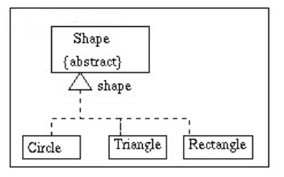
Generalization

Slide 16
Aggregation
specialized form of Association
all objects have their own lifecycle
Example: Department and teacher. A single teacher can not belong to multiple departments,
but if we delete the department teacher object will not be destroyed.
We can think about it as a “has-a” relationship.

Slide 17

Aggregation

Slide 18
Composition
Composition is again specialised form of Aggregation
this as a “death” relationship.
. It is a strong type of Aggregation
if parent object is deleted, all child objects

Slide 19
Composition: Example 1
House and Rooms.
House can contain multiple rooms – there is no independent life of room and any room can not belong to two different houses. If we delete the house – room will automatically be deleted

Slide 20
Composition: Example 2
relationship between Questions and Options.
Single questions can have multiple options and option can not belong to multiple questions. If we delete questions options will automatically be deleted

Slide 21

Composition

Slide 22
Thankyou

